Slide 1
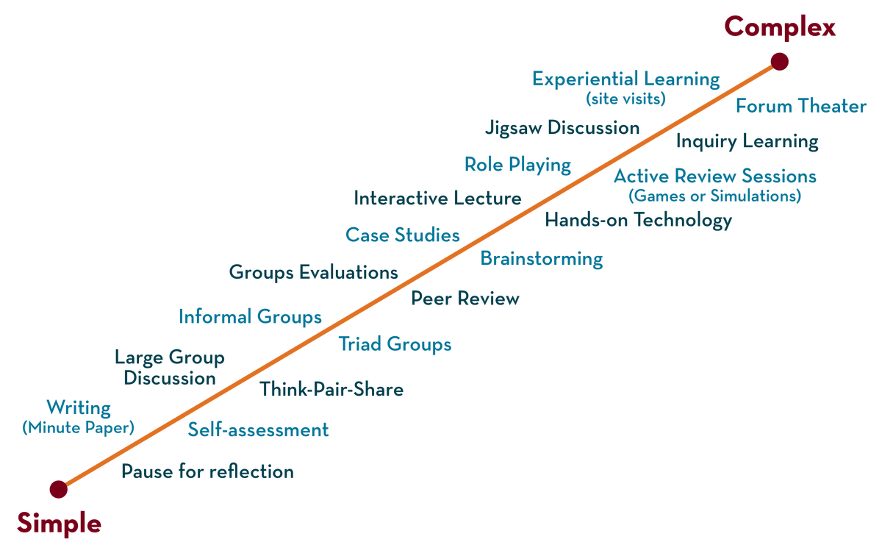
Department of CSE-H
COURSE NAME : Operating Systems
COURSE CODE: 21CS2109RA
Topic:
Unix file system & system calls & Process

Slide 2
AIM OF THE SESSION
To familiarize students with the basic concept of UNIX OPERATING System.
INSTRUCTIONAL OBJECTIVES
This Session is designed to:
Demonstrate UNIX Operating System Commands and System Calls.
Describe what is Unix operating system.
List out the different types of Unix based operating systems.
Describe the role of an operating system.
A Case Study of Operating Systems: UNIX, Linux, ubuntu, centos and Solaris.
LEARNING OUTCOMES
At the end of this session, you should be able to:
Defines Operating System Structure, Components of operating system, Functions of OS.
Describe what an operating systems do, Types of operating systems.
Summarize Role of an Operating System.
A Comparative Study of Operating Systems Commands in Case of Dos and UNIX .
A Case Study of Different Flavors of Linux based Operating Systems: Centos, Debian, Fedora, Kali Linux, Ubuntu, openSUSE.

Slide 3
SESSION INTRODUCTION
WHAT IS UNIX OPERATING SYSTEM?
The Unix operating system is a set of programs that act as a link between the computer and the user.
The computer programs that allocate the system resources and coordinate all the details of the computer's internals is called the operating system or the kernel.
Unix was originally developed in 1969 by a group of AT&T employees Ken Thompson, Dennis Ritchie, Douglas McIlroy, and Joe Ossanna at Bell Labs.
There are various Unix variants available in the market. Solaris Unix, AIX, HP Unix and BSD are a few examples. Linux is also a flavor of Unix which is freely available.

Slide 4
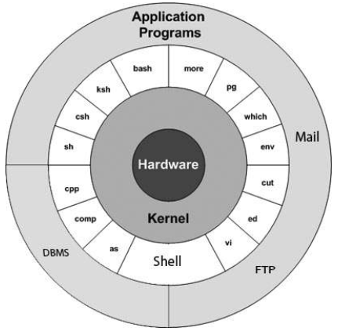
STRUCTURE OF UNIX OS

Slide 5
MAIN CONCEPTS OF UNIX OS
Kernel − The kernel is the heart of the operating system. It interacts with the hardware and most of the tasks like memory management, task scheduling and file management.
Shell − The shell is the utility that processes your requests. C Shell, Bourne Shell and Korn Shell are the most famous shells which are available with most of the Unix variants.
Commands and Utilities − There are various commands and utilities which you can make use frequently cp, mv, cat and grep, etc. are few examples of commands and utilities.
Files and Directories − All the data of Unix is organized into files. All files are then organized into directories. These directories are further organized into a tree-like structure called the filesystem.

Slide 6
SESSION INTRODUCTION
WHAT IS UNIX SHELL COMMANDS?
A Shell provides you with an interface to the Unix system.
Shell accepts human-readable commands from the user and converts them into something which the kernel can understand.
It gathers input from you and executes programs based on that input.
When a program finishes executing, it displays that program's output.
Shell is an environment in which we can run our commands, programs, and shell scripts.
There are different flavors of a shell, just as there are different flavors of operating systems.
Each flavor of shell has its own set of recognized commands and functions.

Slide 7
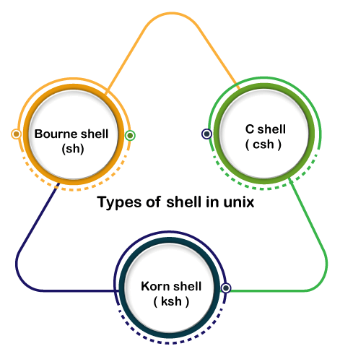
TYPES OF SHELL COMMANDS
Bourne Shell: This Shell is simply called the Shell. It was the first Shell for UNIX OS. It is still the most widely available Shell on a UNIX system.
C Shell: The C shell is another popular shell commonly available on a UNIX system.
Korn Shell: This Shell was created by David Korn to address the Bourne Shell's user-interaction issues and to deal with the shortcomings of the C shell's scripting quirks.

Slide 8
BASIC TERMINAL NAVIGATION COMMANDS:
ls : To get the list of all the files or folders.
ls -l: Optional flags are added to ls to modify default behavior, listing contents in extended form -l is used for “long” output
ls -a: Lists of all files including the hidden files, add -a flag
cd: Used to change the directory.
du: Show disk usage.
pwd: Show the present working directory.
man: Used to show the manual of any command present in Linux.

Slide 9
BASIC TERMINAL NAVIGATION COMMANDS:
rmdir: It is used to delete a directory if it is empty.
ln file1 file2: Creates a physical link.
ln -s file1 file2: Creates a symbolic link.
locate: It is used to locate a file in Linux System
echo: This command helps us move some data, usually text into a file.
df: It is used to see the available disk space in each of the partitions in your system.
tar: Used to work with tarballs (or files compressed in a tarball archive)

Slide 10

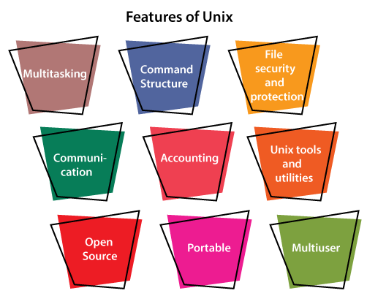
SESSION INTRODUCTION

Slide 11
SESSION INTRODUCTION
WHAT IS SYSTEM CALL ?
A system call is a way for programs to interact with the operating system.
System call provides the services of the operating system to the user programs via Application Program Interface(API).
It provides an interface between a process and operating system to allow user-level processes to request services of the operating system.
System calls are the only entry points into the kernel system. All programs needing resources must use system calls.

Slide 12
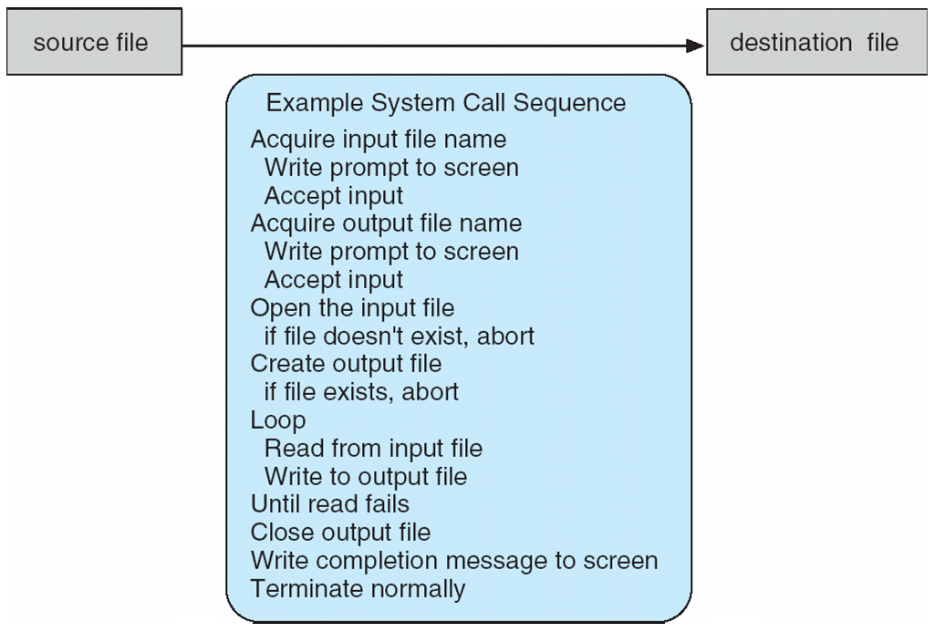
SESSION DESCRIPTION
EXAMPLE OF SYSTEM CALLS
System call sequence to copy the contents of one file to another file

Slide 13
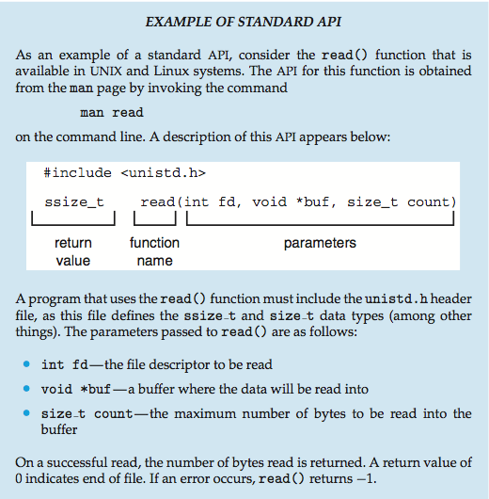
SESSION DESCRIPTION

Slide 14
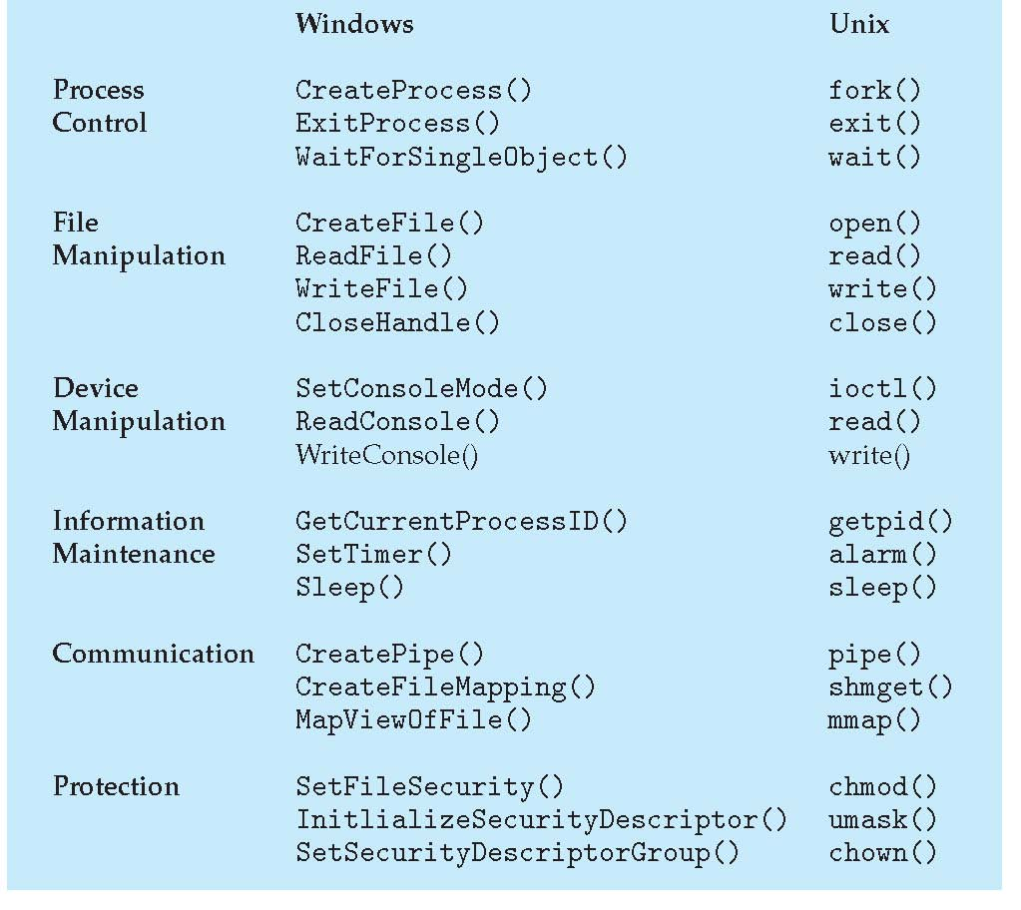
SESSION DESCRIPTION
EXAMPLES OF WINDOWS AND UNIX SYSTEM CALLS

Slide 15
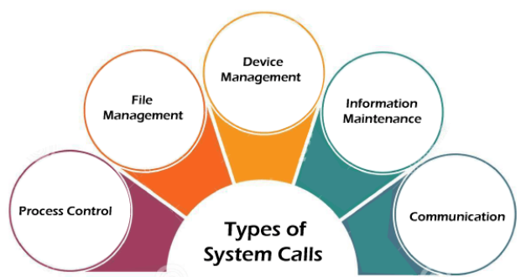
TYPES OF SYSTEM CALLS

Slide 16
TYPES OF SYSTEM CALLS
Process Control : Process control is the system call that is used to direct the processes. Some process control examples include creating, load, abort, end, execute, process, terminate the process, etc.
File Management : File management is a system call that is used to handle the files. Some file management examples include creating files, delete files, open, close, read, write, etc.
Device Management : Device management is a system call that is used to deal with devices. Some examples of device management include read, device, write, get device attributes, release device, etc.
Information Maintenance : Information maintenance is a system call that is used to maintain information.
Examples of information maintenance : Including getting system data, set time or date, get time or date, set system data, etc.
Communication : Communication is a system call that is used for communication.
Examples of communication : Including create, delete communication connections, send, receive messages, etc.

Slide 17
SESSION DESCRIPTION
open() : The open() system call allows you to access a file on a file system. It allocates resources to the file and provides a handle that the process may refer to. Many processes can open a file at once or by a single process only. It's all based on the file system and structure.
read() : It is used to obtain data from a file on the file system. It accepts three arguments in general:
A file descriptor.
A buffer to store read data.
The number of bytes to read from the file.
The file descriptor of the file to be read could be used to identify it and open it using open() before reading.
wait() : In some systems, a process may have to wait for another process to complete its execution before proceeding. The wait() system call is used to suspend the parent process. Once the child process has completed its execution, control is returned to the parent process.

Slide 18
SESSION DESCRIPTION
write() : It is used to write data from a user buffer to a device like a file. This system call is one way for a program to generate data. It takes three arguments in general:
A file descriptor.
A pointer to the buffer in which data is saved.
The number of bytes to be written from the buffer.
fork() : Processes generate clones of themselves using the fork() system call. It is one of the most common ways to create processes in operating systems.
close() : It is used to end file system access. When this system call is invoked, it signifies that the program no longer requires the file, and the buffers are flushed, the file information is altered, and the file resources are de-allocated as a result.
exec() : When an executable file replaces an earlier executable file in already executing process, this system function is invoked.
exit(): The exit() is a system call that is used to end program execution.

Slide 19
SESSION DESCRIPTION
PROCESS
A process is mainly a program in execution where the execution of a process must progress in a sequential order or based on some priority or algorithms.
In other words, it is an entity that represents the fundamental working that has been assigned to a system.
When a program gets loaded into the memory, it is said to as process. This processing can be categorized into 4 sections. These are:
Heap
Stack
Data
Text

Slide 20
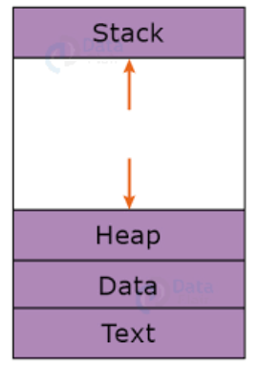
SESSION DESCRIPTION
The Stack is used for local variables. Space on the stack is reserved for local variables when they are declared.
The Heap is used for the dynamic memory allocation and is managed via calls to new, delete, malloc, free, etc.
The Data section is made up of the global and static variables, allocated and initialized prior to executing the main.
The Text section is made up of the compiled program code, read in from non-volatile storage when the program is launched.

Slide 21
SESSION DESCRIPTION
PROCESS API
These APIs are available on any modern OS
Create : OS is invoked to create a new process to run a program.
Destroy : Halt a runway process.
Wait : Wait for a process to stop running.
Miscellaneous control : Some method to suspend a process and then resume it.
Status : Get some status info about a process.

Slide 22
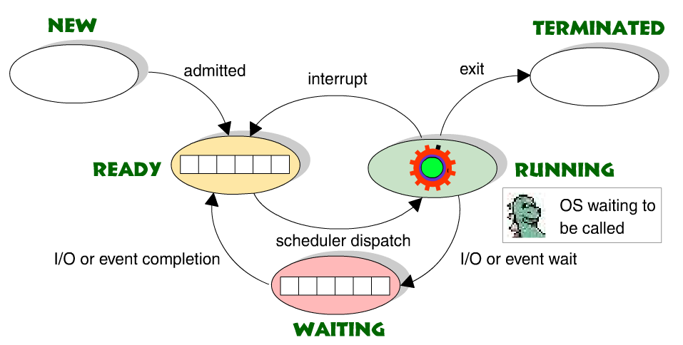
SESSION DESCRIPTION
PROCESS STATES IN OPERATING SYSTEM

Slide 23
Process States in Operating System
Start / New : This is the initial state when a process is first started or created.
Ready : The process is waiting to be assigned to a processor.
Ready processes are waiting to have the processor allocated to them by the operating system so that they can run.
Process may come into this state after Start state or while running it by but interrupted by the scheduler to assign CPU to some other process.
Running : Once the process has been assigned to a processor by the OS scheduler, the process state is set to running and the processor executes its instructions.
Waiting : Process moves into the waiting state if it needs to wait for a resource, such as waiting for user input, or waiting for a file to become available.
Terminated / Exit : Once the process finishes its execution, or it is terminated by the operating system, it is moved to the terminated state where it waits to be removed from main memory. These names are arbitrary, and they vary across operating systems.

Slide 24
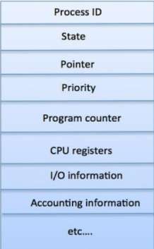
SESSION DESCRIPTION
PROCESS CONTROL BLOCK (PCB)

Slide 25
PROCESS CONTROL BLOCK (PCB)
Process State : The current state of the process i.e., whether it is ready, running, waiting, or whatever.
Process Privileges : This is required to allow/disallow access to system resources.
Process Id : Unique identification for each of the process in the operating system.
Pointer : A pointer to parent process.
Program Counter : Program Counter is a pointer to the address of the next instruction to be executed for this process.
CPU Registers : Various CPU registers where process need to be stored for execution for running state.
CPU Scheduling Information : Process priority and other scheduling information which is required to schedule the process.

Slide 26
PROCESS CONTROL BLOCK (PCB)
Memory Management Information
This includes the information of page table, memory limits, Segment table depending on memory used by the operating system.
Accounting Information
This includes the amount of CPU used for process execution, time limits, execution ID etc.
IO Status Information
This includes a list of I/O devices allocated to the process.
The architecture of a PCB is completely dependent on Operating System and may contain different information in different operating systems.

Slide 27
ACTIVITIES/ CASE STUDIES/ IMPORTANT FACTS RELATED TO THE SESSION
A Case Study of Operating Systems: UNIX, Linux,
A Comparative Study of system calls in Case of Windows and UNIX
A Case Study of Flavors of Different Unix based Operating Systems Oracle Solaris, FreeBSD, Microsoft Xenix, IBM AIX, HP UX (A/P)
A Case Study of Different Flavors of Linux based Operating Systems: Centos, Debian, Fedora, Kali Linux, Ubuntu, openSUSE. (A/P)
A Comparative Study of Windows based Operating Systems: Windows 95, Windows 98, Windows CE, Windows 2000, Windows ME, Windows XP, Windows NT.
ACTIVITY: - Create a Virtual Machine and Install Linux

Slide 28
EXAMPLES
EXAMPLES OF UNIX BASED OPERATING SYSTEM UNIX, Linux, Oracle Solaris, FreeBSD, Microsoft-Xenix, IBM AIX, HP UX. Centos, Debian, Fedora, Kali Linux, Ubuntu, openSUSE.

Slide 29
SUMMARY
The Unix operating system is a set of programs that act as a link between the computer and the user.
The computer programs that allocate the system resources and coordinate all the details of the computer's internals is called the operating system or the kernel.
Users communicate with the kernel through a program known as the shell. The shell is a command line interpreter; it translates commands entered by the user and converts them into a language that is understood by the kernel.
Unix was originally developed in 1969 by a group of AT&T employees Ken Thompson, Dennis Ritchie, Douglas McIlroy, and Joe Ossanna at Bell Labs.
There are various Unix variants available in the market. Solaris Unix, AIX, HP Unix and BSD are a few examples. Linux is also a flavor of Unix which is freely available.
Several people can use a Unix computer at the same time; hence Unix is called a multiuser system.
A user can also run multiple programs at the same time; hence Unix is a multitasking environment.

Slide 30
SELF-ASSESSMENT QUESTIONS
Unix is written in which language?
C
Java
C++
Python
Which of the following is not a variants of Unix?.
Solaris
AIX
BSD
SOL

Slide 31
TERMINAL QUESTIONS
1. Describe in detail about Unix operating system structure
2. List out the features of Unix operating system
3. Analyze role of different types of Unix based operating systems
4. Summarize what Unix operating system do

Slide 32
REFERENCES FOR FURTHER LEARNING OF THE SESSION
REFERENCE BOOKS:
Arpaci-Dusseau, Remzi H., and Andrea C. Arpaci-Dusseau. Operating systems: Three easy pieces. Boston: Arpaci-Dusseau Books LLC, 2018. http://pages.cs.wisc.edu/~remzi/OSTEP/
Silberschatz, Abraham, Peter B. Galvin, and Greg Gagne. Operating system concepts. 10th edition, John Wiley & Sons, 2018.
Tanenbaum, Andrew. Modern operating systems. Pearson Education, Inc., 2009.
SITES AND WEB LINKS:
https://www.cse.iitb.ac.in/~mythili/os/
https://cse.iitkgp.ac.in/~sumantra/courses/os/os_pg.html
https://www.cse.iitd.ernet.in/os-lectures

Slide 33
THANK YOU
Team – Operating System

